Slide 1
Part C: Risk Monitoring and Reporting
Enterprises rely on monitoring and reporting functions to identify risk for assessment and response.
The risk practitioner can best manage risk when monitoring is broad enough to provide a reasonable view of the risk environment
Identification and use of key risk indicators (KRIs), performance (KPIs) and controls (KCIs) can greatly improve the process of monitoring.
In addition, periodic assessments and testing may also be necessary as a means of identifying new and emerging risk.
Because of the changing nature of risk and associated controls, continuous monitoring is an essential step of the risk management life cycle as seen in figure 3.12.

Slide 2
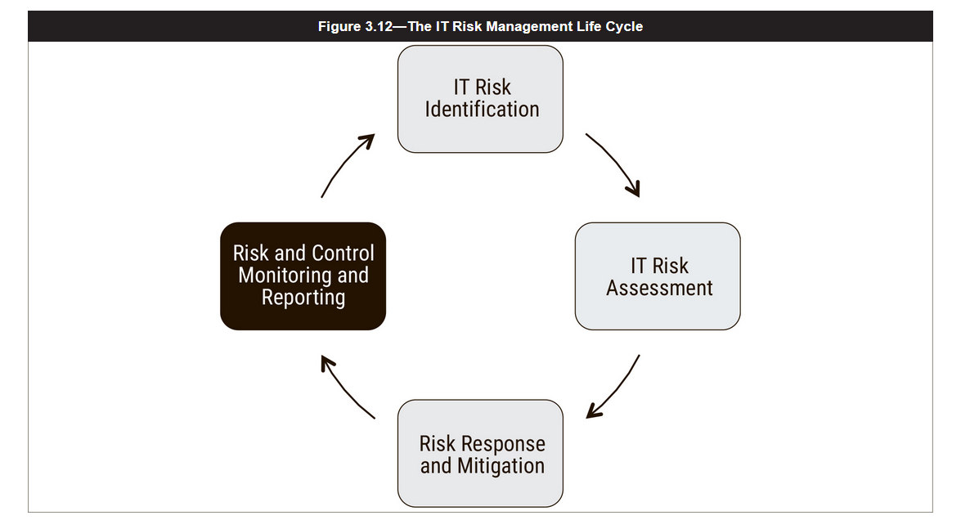

Slide 3
Risk and Control Monitoring Techniques
  To support the ability to monitor and report on risk, the risk practitioner should ensure that processes, logs and audit hooks are commonly placed into the control framework, which allows for the monitoring and evaluation of controls.
  As controls are designed, implemented and operated, the risk practitioner should ensure that logs are enabled, controls are able to be tested and regular reporting procedures are developed.
  The actual monitoring and reporting of controls should be performed in the risk monitoring phase of risk management; however, the risk practitioner should ensure that the capability to monitor a control and to support monitoring systems is addressed in control design.
  If the organization is using a managed security service provider (MSSP) or a SIEM system, the ability to capture data and the notification to the operations staff on the deployment of the system are necessary.

Slide 4
Monitoring Controls
The risk practitioner should work with stakeholders to set up an IS control monitoring process that reflects objectives, scopes and methods consistent with enterprise objectives and integrate this approach with performance management at the enterprise level.
The risk practitioner should remember that purpose of control monitoring is to verify whether the control is effectively addressing the risk, not to see whether the control itself is working. For example, a firewall that is configured in a way that does not regulate traffic between two networks may be ineffective even if the firewall is operational and processing traffic.
Risk monitoring and evaluation are processes performed to:
  Monitor processes to ensure that they are performing in line with established performance metrics
  Provide reports that are systematic and timely
Sources of control monitoring information include:
  Network operations centers (NOC)
  Security operations centers (SOC)
  Command and control centers
  Continuous control monitoring
  Periodic testing
  Independent assessments

Slide 5
Control Assessment Types
  1. Self-assessment
  Controls are most easily assessed by those who regularly interact with them as part of their job functions, operational staff can determine the general effectiveness of controls on a recurring basis.
  In time, these self- assessments establish baselines, which can be used to highlight deviations that may indicate control weaknesses or failures.
  Self-assessment is included in methodologies propagate by NIST as well as the COBIT and COSO frameworks.
  2. IS Audit
  Audit teams provide independent and objective review of the effectiveness and appropriateness of the control environment.
  Information provided by IS auditors can underline the need for control enhancement and bring risk to the attention of management along with strong supporting evidence.

Slide 6
3. Vulnerability Assessment
  A vulnerability assessment helps identify, classify, and prioritize vulnerabilities in network infrastructure, computer systems, and applications.
  A vulnerability is a security weaknesses that might expose the organization to cyber threats or risks. Vulnerability assessments often employ automated testing tools such as network security scanners, showing the results in a vulnerability assessment report.
  The scope of an assessment may range from a single system or application to an entire facility or end-to-end business process.
  The purpose of the assessment is to deliver information to management that can be used both to understand the effectiveness of the risk management program and make decisions regarding treatment of identified vulnerability, such as deploying new controls.
  A risk practitioner participating in a vulnerability assessment should have a working knowledge of both technical and nontechnical security controls in the environment and the overall architecture.
  vulnerabilities may be accepted by management if the only available mitigation strategies cost more than the potential impact of compromise.

Slide 7
4. Penetration Testing
  A penetration test is a targeted attempt to break into an environment.
  As with a vulnerability assessment, the target of a penetration test may be a system, application, facility or end-to-end business process.
  If the goal of a penetration test is to validate a vulnerability assessment, the tester is typically given the results of the assessment in order to focus on attempts to exploit the vulnerabilities that have already been identified.
  If the penetration tester is able to break in, then the vulnerability is real and must be mitigated; otherwise, there is a good chance that the vulnerability may be a false positive and not require mitigation.
  This validation-centric approach is typically called a white hat penetration test.
  Penetration tests can also be undertaken against systems believed to be secure. In order to test the effectiveness of the security associated with such a system
  It is also essential that the results of penetration testing be used as the basis for improvement, which is what distinguishes a penetration test from a practical audit.
  In environments where a Red Team operates, this improvement can be made nearly continuous through active engagement between the Red and Blue teams to review lessons learned a partnership sometimes called the Purple Team to denote the commitment from both teams.

Slide 8
Risk and Control Reporting Techniques
  Risk practitioners are commonly expected to provide regular reports to management and the board of directors on the status of the risk management program and the overall risk profile of the enterprise.
  Making such a report requires the review of the effectiveness of the controls in the enterprise and their compliance with established policy.
  Controls may need adjustment, replacement or removal depending on the changes in the risk environment and the acceptance and appropriateness of the controls.
  The effectiveness of control monitoring is dependent on the following:
    Timeliness of the reporting ---are data received in time to take corrective action?
    Skill of the data analyst ---does the analyst have the skills to properly evaluate the controls?
    Quality of monitoring data available ---are the monitoring data accurate and complete?
    Quantity of data to be analyzed ---can the risk practitioner find the important data in the midst of all the other log data available?

Slide 9
What is a risk report?
  A risk report is a summary that describes the potential risks a company may face. They address critical risks, which have the potential for severe consequences, and emerging risks that may become problematic in the future if someone doesn't monitor them closely.
  A report also explores possibilities for addressing risks and preventing adverse outcomes.
  The project manager, the project team or the risk owner writes the reports.
  The report may include :
    How effective the company is at handling potential risks
    Which policies seem insufficient
    Which controls aren't working as planned
    What changes are necessary to keep risk at an acceptable level
    What the updated status of corrective actions is
    What the signs of trends in the incidence of risks are
  Senior management read risk reports to take on adequate risk management and achieve expected project results.

Slide 10
What should the report address
Risk reports may address various types of risks, including:
  Commercial risks: These are economic or market risks, including changes in prices and demand.
  Compliance and regulatory risks: This includes the risk of violating a law or regulation, such as inadequate capacity or fraud.
  Environmental risks: These are the risk of unwanted accidents, such as a natural disaster like a flood.
  Financial risks: The possibility of losing money on a business venture, potentially due to changes in interest rates, is a financial risk.
  Health and safety risks: These include the possibility of illness or injury, potentially from infectious diseases or slipping and getting injured.
  Operational risks: These are the chances a company takes by operating normally, potentially due to employee conduct or technology risks.
  Reputational risks: The risk of damaging corporate reputation, potentially due to social media misuse or a data breach, it's a reputational risk.
  Strategic risks: These are the risks that failed business decisions may have on the company, possibly from a merger or due to senior management turnover.
  Workforce risks: These risks are linked to employees, such as employee safety and stress.

Slide 11
Types of risk reports
There are four main types of risk reports based on level, starting on a project level and working up to a business level. These risk report types include:
Project risk reports
  Projects benefit from having a project risk report. Teams may use a risk log to document potential risks. These risks may include external factors that can affect the project, such as the risks of price fluctuations for necessary materials, resource shortages and contractors not completing their work. The risk log includes actions to minimize the risk and designates an owner who is the individual responsible for completing an action.
Program risk reports
  Sometimes projects are part of more extensive programs, in which program risk reports are necessary. Program team members may record relevant program risks, such as elevated project risks because of criticality or due to overlapping between projects. The program manager uses program risk reports to ensure that risks are mitigated and don't escalate. Program teams typically complete program reports monthly.
Portfolio risk reports
  Portfolio risk reports present significant risks for all projects and programs within the portfolio in a comprehensive and easy-to-read summary. These reports are written by the project management officer and contain data taken from project and program risk reports.
Business risk reports
  Some organizations use business risk reports, which focus on the most significant risks across the entire company. These reports may include emerging risks, operational activities, current market outlooks and competitor analysis. As these reports are often lengthy documents that may be over 10 pages long, it's helpful to display information visually, using graphs and charts, when possible. Including an executive summary can be beneficial to readers when they're looking for the critical points of the report.

Slide 12
Key Performance Indicators
  Performance indicators measure how well a process is performing in terms of its stated goal.
  This measurement provides insight into whether action may be required, with the goal of allowing changes to be made before significant impacts occur.
  a subset of these indicators are effective in predicting whether organizational goals will be reached and indicates the capabilities, practices and skills of value to the organization.
  KPIs measure activity goals, which are actions that process owners must take to achieve effective process performance.
  They are commonly used to set benchmarks for risk management goals and to monitor whether those goals are being attained.
  Management sets its risk management goals according to its risk acceptance level and desired cost-benefit analysis.
  For example, a KPI may indicate that an error rate of five percent is acceptable, which implies that an error rate higher than five percent is unacceptable and requires escalation with some form of response.

Slide 13
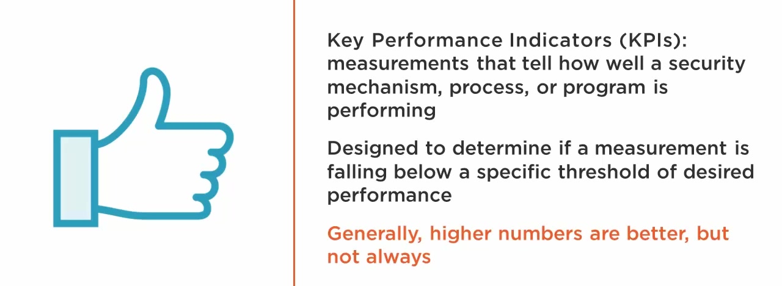

Slide 14
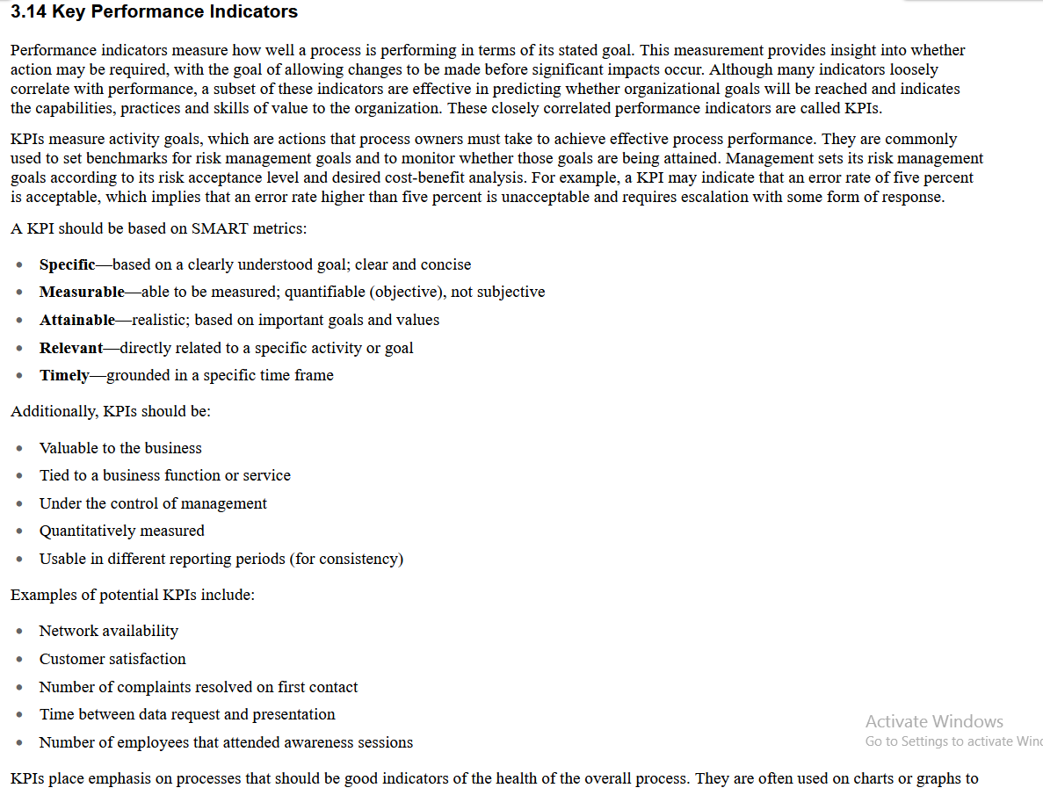

Slide 15
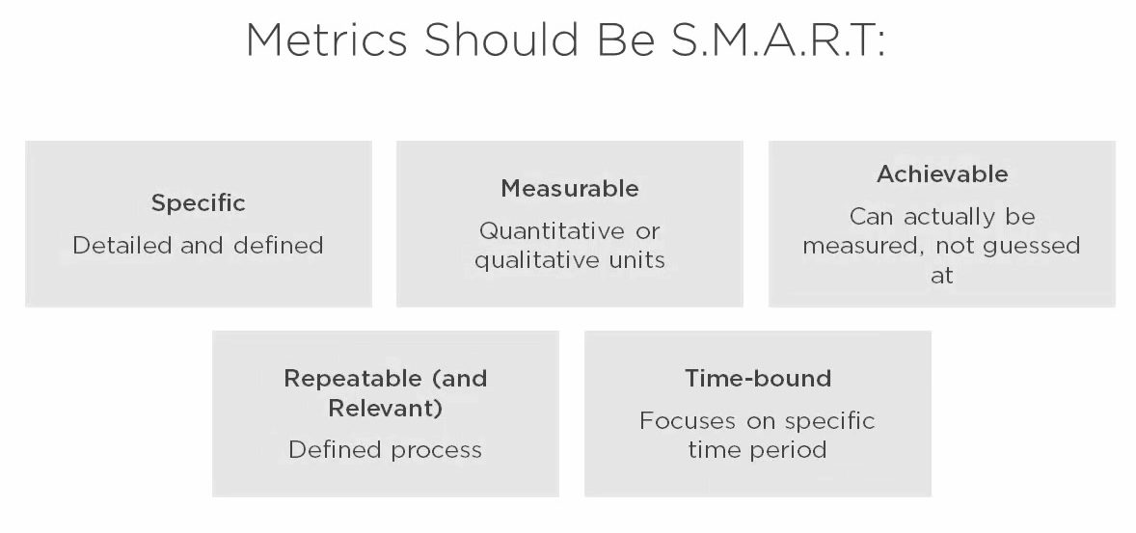

Slide 16
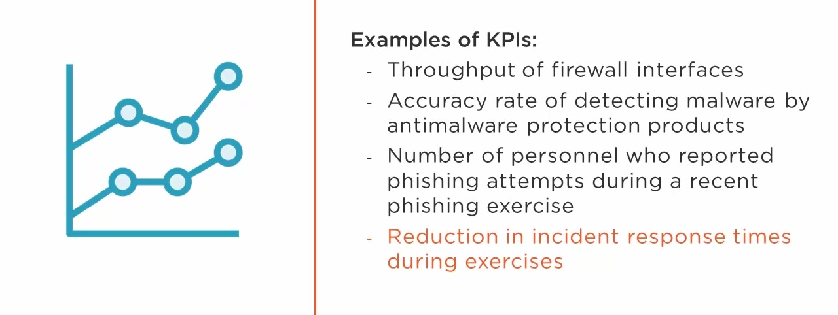
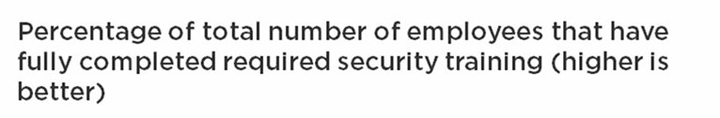
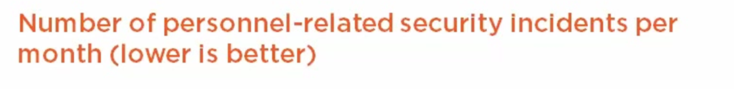

Slide 17
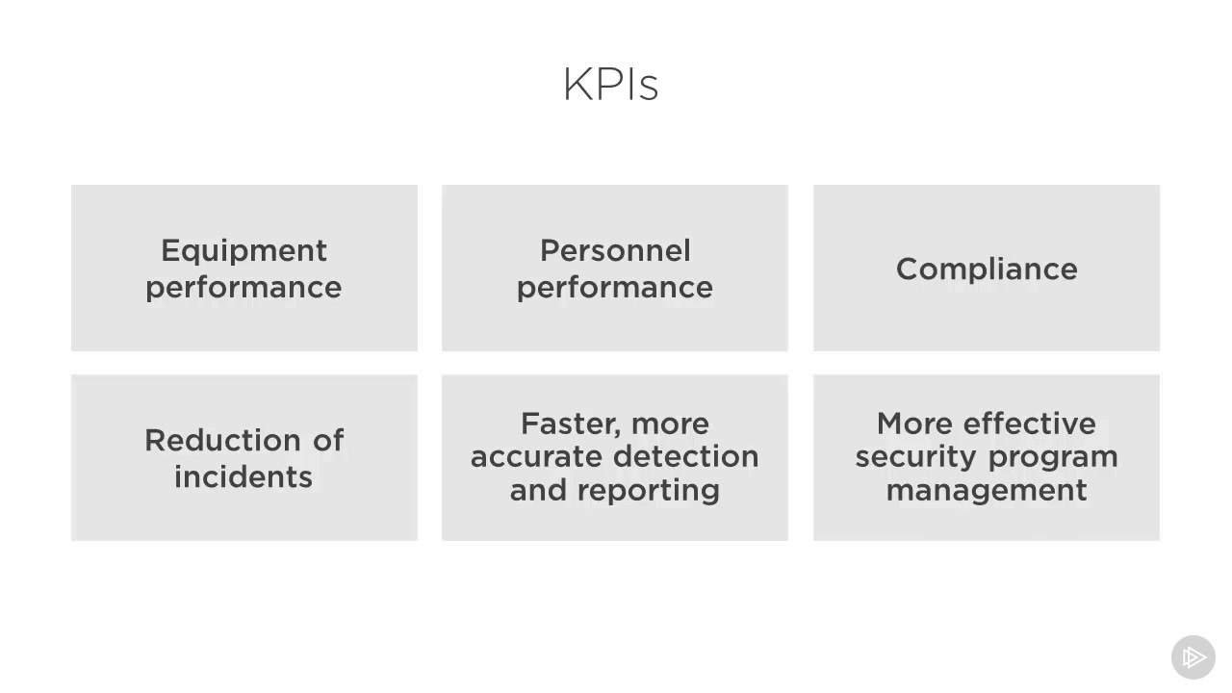

Slide 18
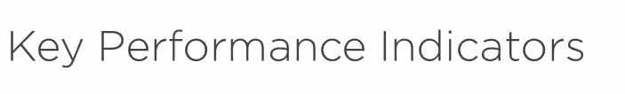
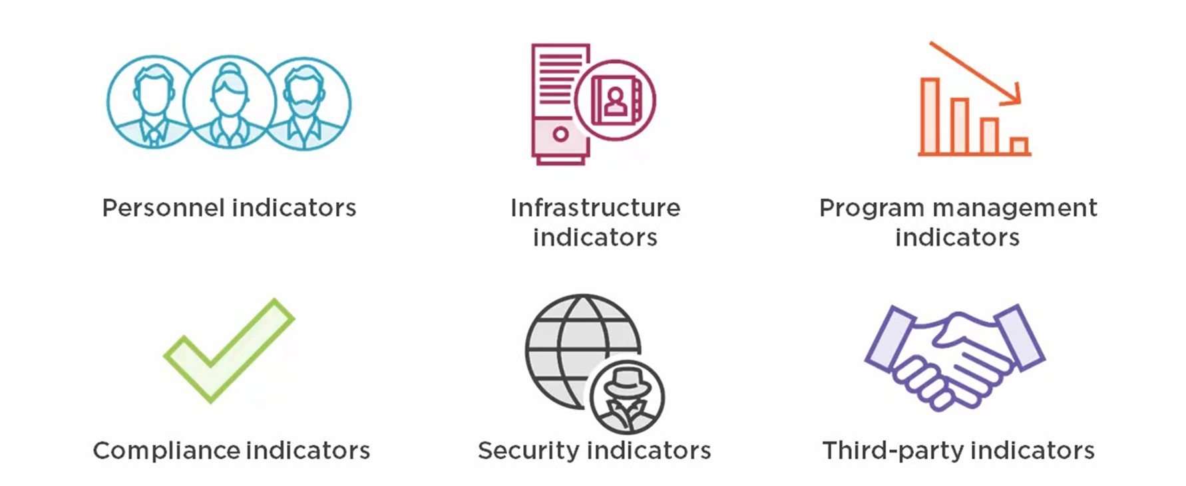

Slide 19
Key Risk Indicators
Risk indicators are used to measure risk levels in comparison to defined risk thresholds, so that the organization receives an alert when a risk level approaches an unacceptable level.
By putting tracking and reporting mechanisms in place that alert staff to a developing or potential risk, the enterprise gains the opportunity to respond to the risk before it produces unacceptable outcomes.
Key risk indicators (KRIs) comprise a subset of risk indicators that are highly relevant and possess a high probability of predicting or indicating important risk.
Examples of KRIs include:
  Number of unauthorized equipment or software detected in scans
  Number of instances of SLAs exceeding thresholds
  High average downtime due to operational incidents
  Average time to deploy new security patches to servers
  Excessive average time to research and remediate operations incidents
  Number of desktops/laptops that do not have current antivirus signatures or have not run a full scan within scheduled periods
KRIs support numerous aspects of risk management, including:
  Risk appetite, by validating the enterprise’s risk appetite and risk tolerance levels
  Risk identification, by providing an objective means for identifying risk
  Risk mitigation, by providing a trigger for investigating an event or providing corrective action
  Risk culture, by helping the enterprise focus on important, relevant areas
  Risk measurement and reporting, by providing objective and quantitative risk information
  Regulatory compliance, by providing data that can be used as an input for operation risk capital calculations

Slide 20
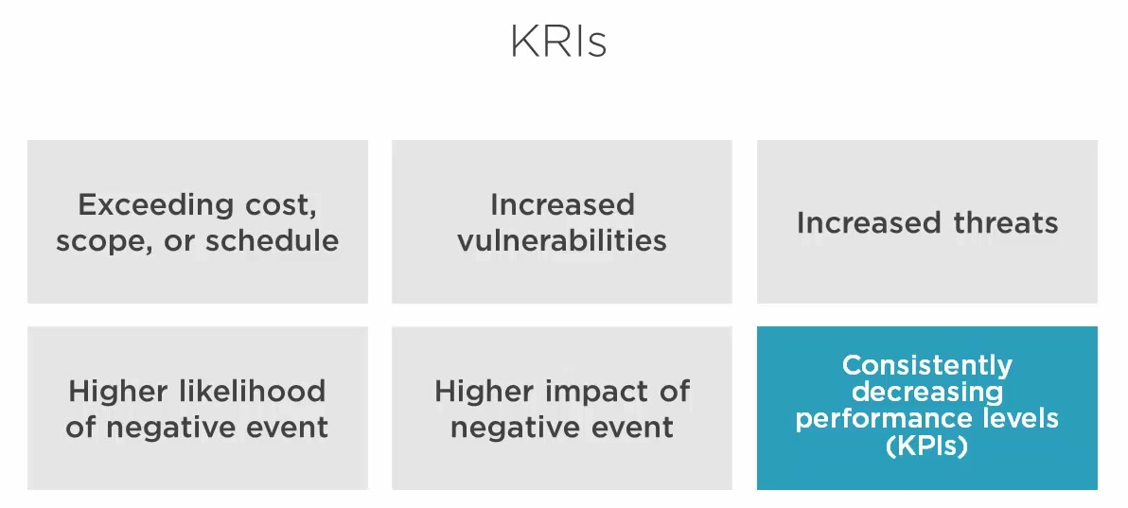

Slide 21
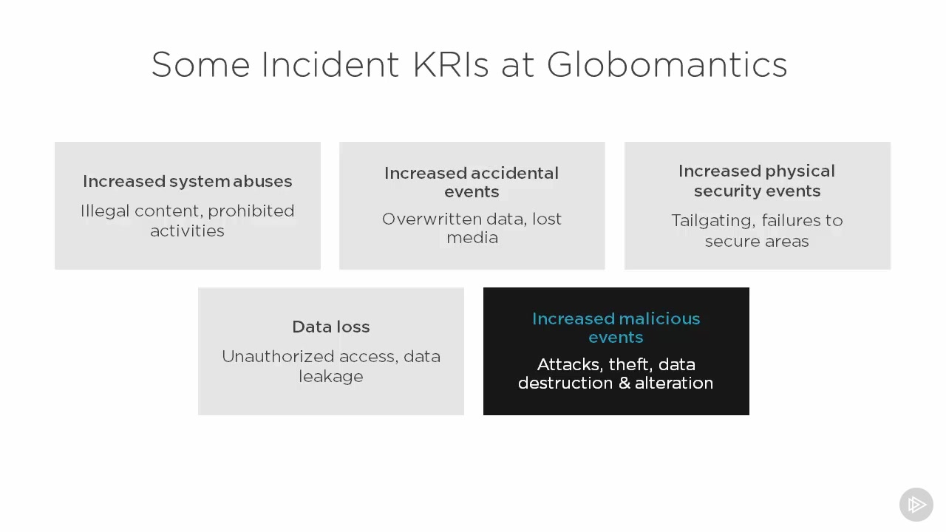

Slide 22
Key Control Indicators
  Certain indicators reveal the effectiveness of controls. Of these, the subset that quantifies how well a specific control is working constitutes the set of key control indicators (KCIs).
  The goal of KCIs is to track performance of control actions relative to tolerances, providing insight into the ongoing adequacy of a given control in keeping risk within acceptable levels.
  For this reason, they are sometimes called control effectiveness indicators.
  Examples of KCIs include the numbers of:
    Phishing emails not blocked by filtering systems (indicating a weakness in features or tuning and leading to a higher risk of compromise linked to phishing)
    Administrators with rights to both test and production environments (indicating a weakness in procedures intended to establish and maintain segregation of duties)
    Unsolicited prompts for second-factor authentication (indicating a weakness in password security allowing would-be hackers to reach the second stage of authentication)

Slide 23
The Benefits of KCIs
There are a number of benefits of KCIs:
  Better Focus: KCIs focus on ensuring that internal controls are effective in a measurable way.
  Early Warning: KCIs can often be viewed as leading KRIs in the sense that failure of a Control is an early warning signal for the failure of a Risk. For example, a KCI that flags the potential failure of IT security Controls is likely to determine the potential of a security Risk sooner than KRIs that measure security failures directly.
  Wider Impact: Because Controls can mitigate multiple Risks, effective KCIs have the potential to positively impact multiple risk areas within an organization.
  Audit Friendly: Many organizations will have an audit function as part of their “three lines of defense” governance model. A core part of this activity is an audit of existing controls to ensure that they are working effectively to reduce Risk. Obviously, KCIs can assist in this activity by providing Auditors with clear metrics with which to assess the effectiveness of controls.

Slide 24
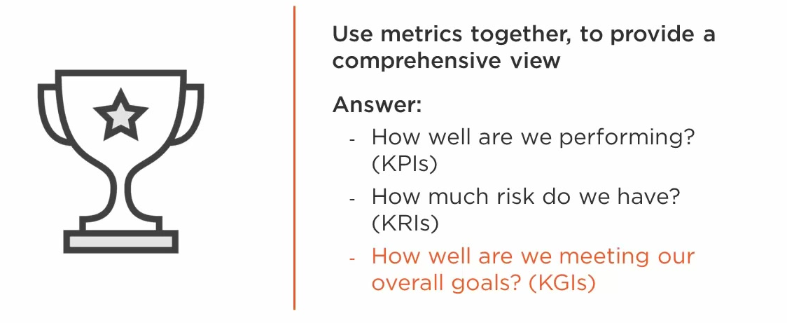

Slide 25
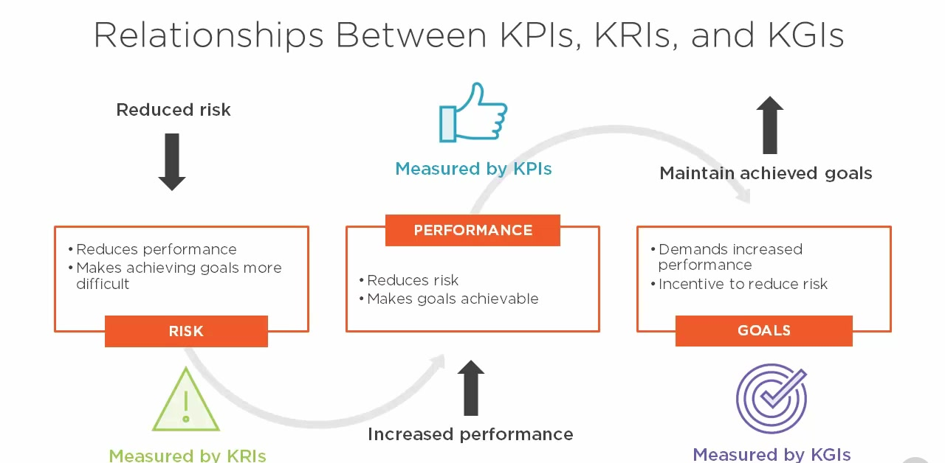

Slide 26
Thank you

